Slide 1
Network Intrusion Detection
CAPSTONE PROJECT
Presented By:
Syed Safi Ullah
Nawab Shah Alam Khan College of Engineering and Technology
CSE (AI&ML)

Slide 2
OUTLINE
Problem Statement (Should not include solution)
Proposed System/Solution
System Development Approach (Technology Used)
Algorithm & Deployment
Result (Output Image)
Conclusion
Future Scope
References

Slide 3
Problem Statement
Networks today face a constant barrage of sophisticated cyberattacks that are impossible for humans to monitor effectively. The core challenge is the need for an automated system that can instantly and accurately detect these threats.
Information Overload: The sheer volume of network traffic makes it impossible to manually inspect every connection for malicious intent.
Stealthy Attacks: Many attacks, like network probes or privilege escalations, are designed to look like normal activity, making them difficult to spot.
The Need for Speed: A security team needs to know about an attack the moment it happens. Delays can lead to significant data loss and system damage.

Slide 4
Proposed Solution
To address the problem, we developed an end-to-end machine learning pipeline on the IBM Cloud platform. The solution is designed to automatically process network data, identify threats, and classify them into specific categories.
Data Preparation & Preprocessing:
Utilized the KDD'99 dataset, containing thousands of labeled network connections.
Built a data pipeline using scikit-learn to clean the data, handle different data types (text and numbers), and prepare it for model training.
Intelligent Model Training:
Trained a powerful RandomForestClassifier to learn the patterns of normal versus malicious network traffic.
The model was specifically trained to perform multiclass classification, distinguishing between Normal, DoS, Probe, R2L, and U2R attack types.
Automated Model Optimization with AutoAI:
Leveraged IBM's AutoAI service to automatically build, train, and rank dozens of different machine learning models.
This ensures that the final selected model has the highest possible accuracy and performance, automating a process that would otherwise take weeks of manual effort.

Slide 5
System Approach
System Requirements
Cloud Platform: An IBM Cloud "Lite" account is required to access the necessary services.
Core Services:
IBM Watson Studio: The central integrated development environment (IDE) for building and managing the project.
IBM Cloud Object Storage: Used for secure and reliable storage of datasets and project assets.
watsonx.ai Runtime: Provides the computational engine (CPU/RAM) to execute the Jupyter Notebook and AutoAI experiments.
Development Tool: A Jupyter Notebook within Watson Studio serves as the primary tool for coding, data analysis, and model training
Libraries Required
Core Data Science: pandas, numpy, scikit-learn
Visualization: matplotlib, seaborn
IBM Cloud SDK: ibm_boto3

Slide 6
Algorithm & Deployment
Algorithm Selection:
Chose the RandomForestClassifier for its high accuracy and ability to handle complex, mixed data types.
Validated the approach using IBM AutoAI, which tested dozens of models and confirmed a tree-based ensemble was superior, achieving 88.3% accuracy.
Data Input:
The model was trained on all 41 features from the KDD'99 dataset, including connection duration, protocol type, service, and host-based traffic statistics.
Training Process:
Used a scikit-learn pipeline to automate data preprocessing, applying Standard Scaling to numbers and One-Hot Encoding to text.
Trained the model on an 80% split of the data, ensuring robust evaluation on an unseen 20% validation set.
Deployment Strategy:
The best-performing model from the AutoAI experiment was saved as a production-ready asset in IBM Watson Studio.
The saved model is now prepared for deployment as a REST API, enabling real-time threat detection in any network monitoring application.

Slide 7
Result
Model Performance Summary
Modeling Platform: IBM watsonx.ai Studio – AutoAI
Prediction Target: attack_category (multi-class classification)
Accuracy and Effectiveness
Top-performing model: Pipeline 10 – Batched Tree Ensemble Classifier (XGBoost)
Cross-validated Accuracy: 88.3%
Specialization: Incremental Learning (INCR)
Enhancements Used: Hyperparameter Optimization (HPO), Feature Engineering (FE), Batch Ensemble (BATCH)
Build Time: 6 minutes
Other high-performing models: Pipelines 9, 7, 6, and 8 also achieved very close performance (~88.2%–88.3%).

Slide 8
Effectiveness in Predicting Attack Categories
Precision, Recall & F1 Scores analyzed for each pipeline:
Consistent performance across multiple metrics.
Strong macro/micro recall and precision (~0.88–0.89) in top pipelines.
Lowest log loss in well-performing pipelines, indicating stable predictions.

Slide 9
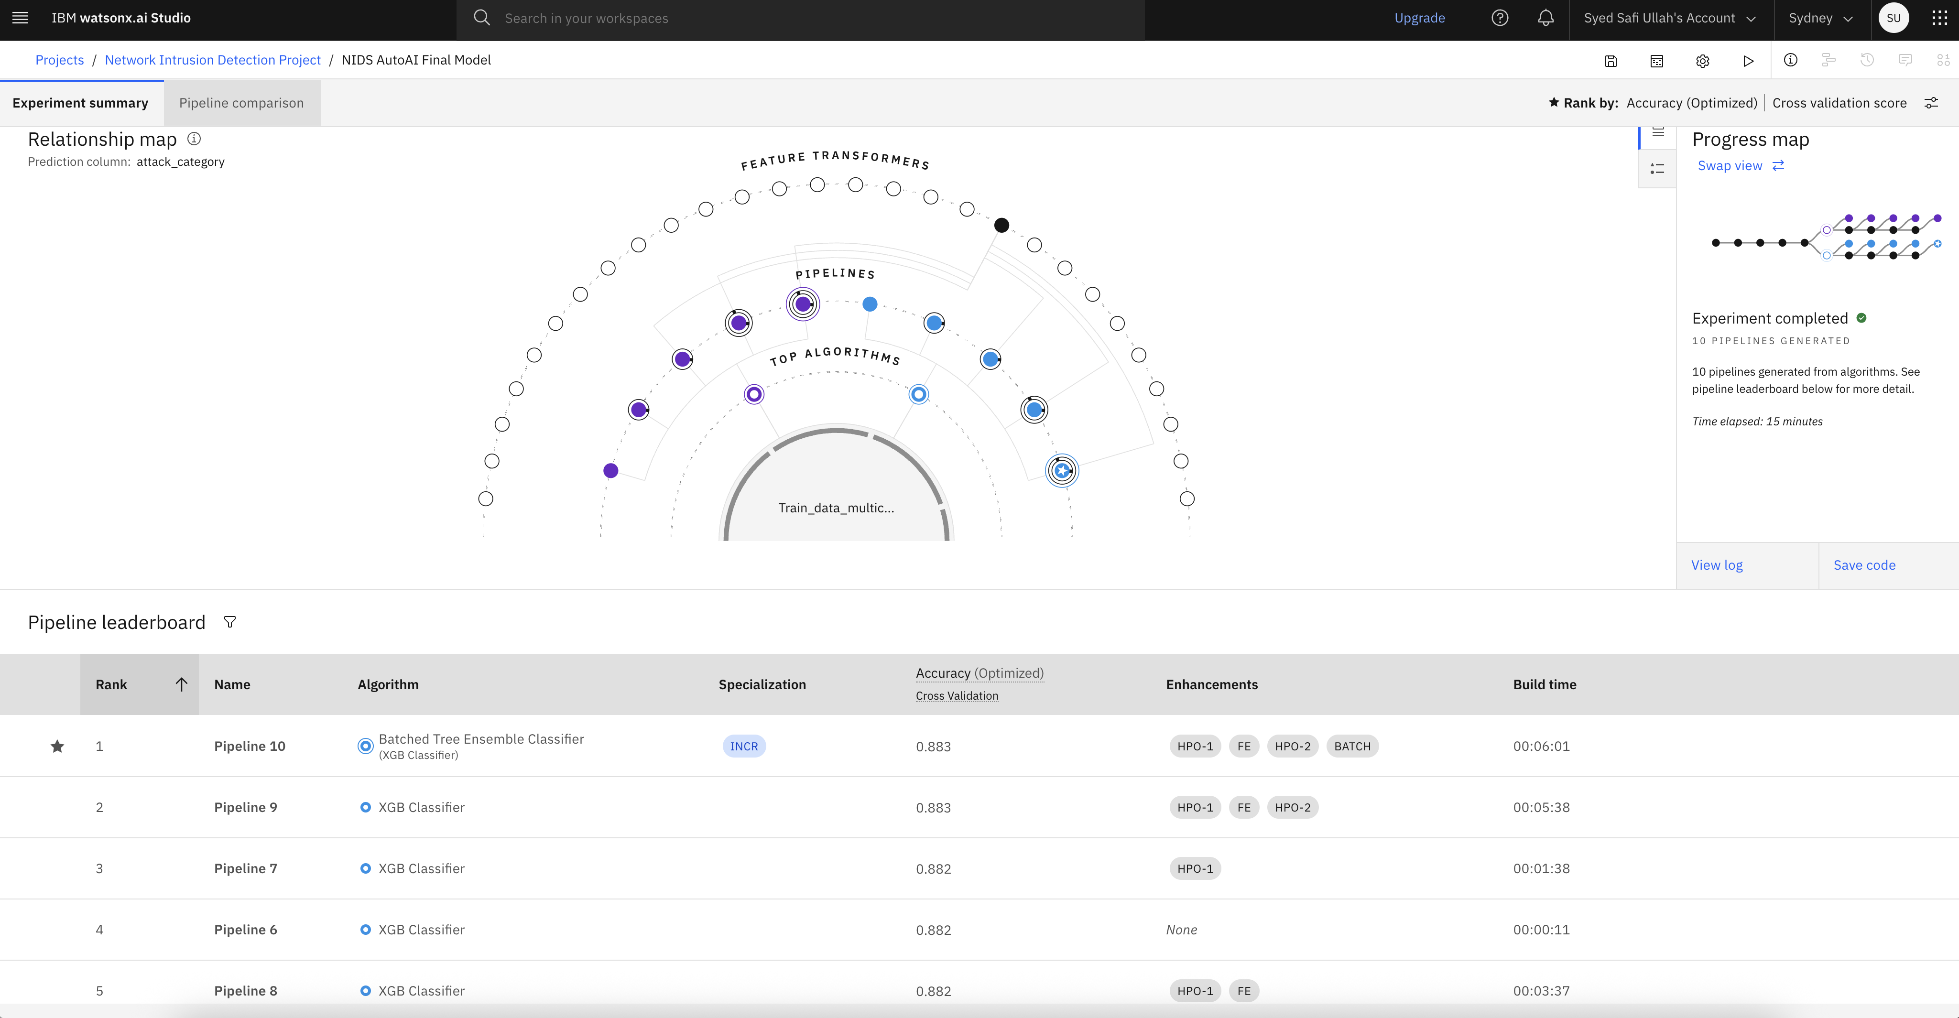

Slide 10
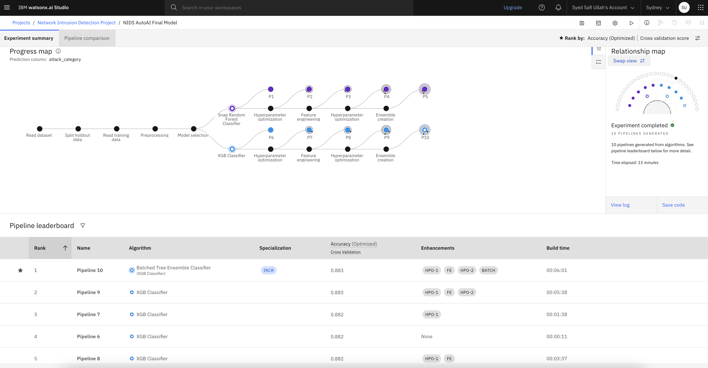

Slide 11
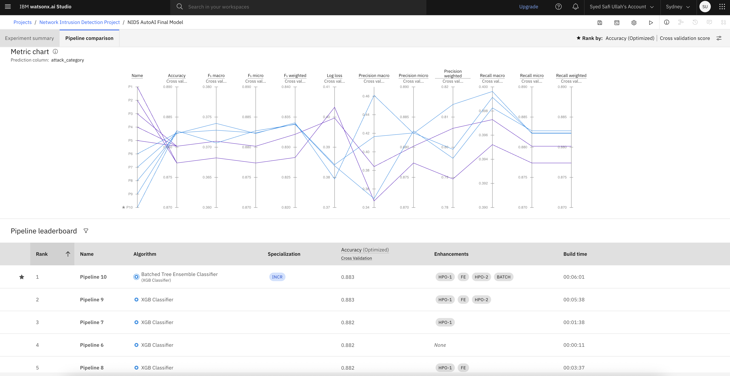

Slide 12
Conclusion
Best Model: Batched Tree Ensemble Classifier achieved the highest accuracy (88.3%)
Effectiveness: Confirms strong capability in detecting and classifying network attacks
Pipeline Strength: Combination of Feature Engineering (FE), Hyperparameter Optimization (HPO), and Ensembling enhanced model performance
Key Takeaway: Ensemble models with automated ML pipelines are highly effective for intrusion detection
Challenges: Data asset syncing and loading in IBM Watson Studio required use of platform-specific SDKs (e.g., ibm_boto3)

Slide 13
Future scope
Integrate More Data: Add logs from firewalls, routers, and cloud sources
Optimize Models: Use hyperparameter tuning & model pruning
Expand Coverage: Scale to multiple networks, cities, or regions
Use Edge Computing: Enable on-device threat detection with low latency
Advanced ML Techniques: Explore graph-based and self-learning models
Real-Time Alerts: Deploy APIs with dashboard integration for live monitoring

Slide 14
References
Dua, D. & Graff, C. (2017). UCI Machine Learning Repository. https://archive.ics.uci.edu
Moustafa, N., & Slay, J. (2015). UNSW-NB15 Dataset. Military Communications and Information Systems Conference
Breiman, L. (2001). Random Forests. Machine Learning, 45(1), 5–32.
IBM Cloud Docs – AutoAI and Watson Studio. https://cloud.ibm.com/docs/
Brownlee, J. (2020). Data Preparation for Machine Learning. Machine Learning Mastery.
Pedregosa et al. (2011). Scikit-learn: Machine Learning in Python. JMLR, 12, 2825–2830.
Gulli, A. & Pal, S. (2017). Deep Learning with Keras. Packt Publishing.
Kumar, V., & Singh, M. (2020). A review on intrusion detection systems using machine learning. Procedia Computer Science, 167, 636–645.

Slide 15
IBM Certifications

Slide 16
IBM Certifications

Slide 17
IBM Certifications

Slide 18
THANK YOU

